Slide 1



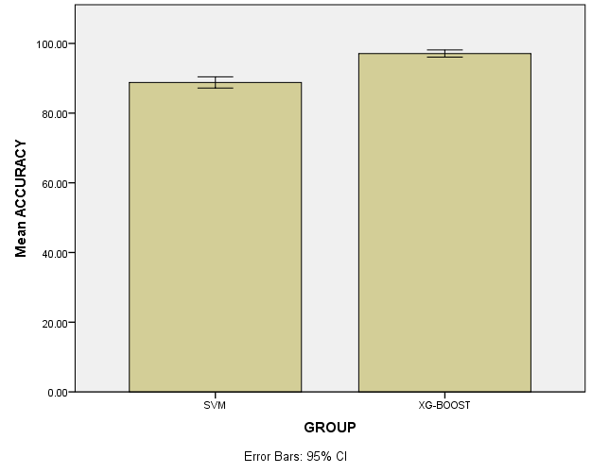
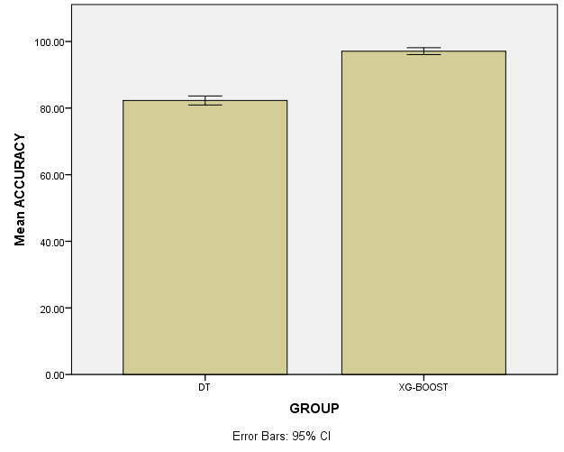


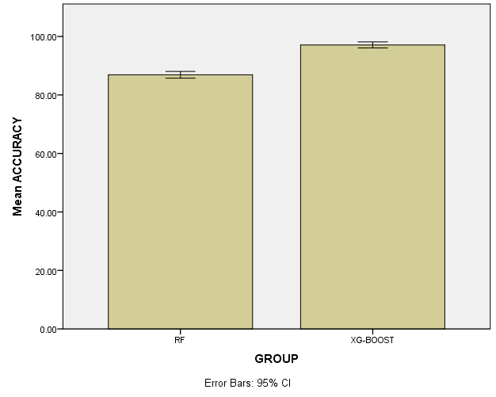

Register No: 192211826
Student Name: R K Sachin
Guided By Dr. R. Karthik Raja
Comparative Analysis of XGBoost and SVM for Identifying Network Flooding Attacks
Evaluating XGBoost and Decision Tree Models for Large-Scale Cyber Intrusion Detection
INTRODUCTION
INTRODUCTION
Network flooding attacks, such as Distributed Denial of Service (DDoS), pose a serious threat to network availability and reliability.
Detecting such attacks promptly and accurately is essential to maintaining secure and uninterrupted network operations.
Support Vector Machines (SVM) are powerful classification models known for their robustness in high-dimensional spaces and effectiveness in binary classification tasks.
XGBoost, a scalable and efficient gradient boosting algorithm, offers strong predictive performance and is well-suited for handling complex, large-scale datasets.
Cyber intrusion detection is a critical component of cybersecurity, aimed at identifying unauthorized access or malicious activities in network systems.
With the exponential growth in data generated by networks, there is a pressing need for efficient and scalable machine learning models to handle large-scale intrusion detection tasks.
Decision Trees are widely used for their simplicity, interpretability, and relatively low computational cost, making them suitable for real-time detection scenarios.
XGBoost, an optimized gradient boosting framework, has gained popularity due to its superior performance, speed, and ability to handle high-dimensional data efficiently.
MATERIALS AND METHODS
MATERIALS AND METHODS
Text here
Collect and preprocess DDOS Dataset
Split data
Load pre-trained models
Train models separately
Evaluate and compare performance
Input Acquisition
Data splitiing
Model setup
Model Training
Precision Evaluation
Flowchart of identifying DDOS attack Using XGBoost and Support Vector Machine
Flowchart of identifying DDOS attack Using XGBoost and Support Decision Tree
RESULTS
RESULTS
Group Statistics
 | GROUP | N | Mean | Std. Deviation | Std. Error Mean
ACCURACY | XG-BOOST | 10 | 97.1000 | 1.44914 | .45826
 | SVM | 10 | 86.8000 | 2.25093 | .71181
Group Statistics
 | GROUP | N | Mean | Std. Deviation | Std. Error Mean
ACCURACY | XG-BOOST | 10 | 97.1000 | 1.44914 | .45826
 | Decision Tree | 10 | 82.3000 | 1.88856 | .59722
Table 1: accuracy comparison table XGBoost and Support Vector Machine
Figure 1: Accuracy comparison of the XGBoost with Support Vector Machine
Table 1: accuracy comparison table XGBoost and Decision tree
Figure 1: Accuracy comparison of the XGBoost with Decision tree.
DISCUSSION AND CONCLUSION
DISCUSSION AND CONCLUSION
Based on T-test Statistical analysis, the significance value of p=0.001 (independent sample T - test p<0.05) is obtained and shows that there is a statistical significant difference between the group 1 and group 2.
Overall , the accuracy of the XGBoost (97.10 %) was better than the Support Vector Machine
( 86.80%).
The results highlight that XGBoost is better suited for ddos classification tasks and identifying botnet.
Based on T-test statistical analysis, the significance value was p = 0.001 (p < 0.05), showing a statistically significant difference between XGBoost and Decision Tree performance.
XGBoost achieved an accuracy 97.1%, while Decision Tree resulted in a lower accuracy of 82.3 %.
Incorporating additional features such as app descriptions, usage frequency, and reviews may improve the effectiveness of both supervised and unsupervised models.
Challenges include dealing with unlabeled datasets, evolving app behaviors, and optimizing unsupervised methods for better clustering relevance.
BIBLIOGRAPHY
BIBLIOGRAPHY
Chen, T., & Guestrin, C. (2016). XGBoost: A Scalable Tree Boosting System. Proceedings of the 22nd ACM SIGKDD International Conference on Knowledge Discovery and Data Mining, 785–794.
Cortes, C., & Vapnik, V. (1995). Support-vector networks. Machine Learning, 20(3), 273–297.
Moustafa, N., & Slay, J. (2015). UNSW-NB15: A Comprehensive Data Set for Network Intrusion Detection Systems. Proceedings of the Military Communications and Information Systems Conference (MilCIS), 1–6.
Ahmed, M., Mahmood, A. N., & Hu, J. (2016). A survey of network anomaly detection techniques. Journal of Network and Computer Applications, 60, 19–31
Tavallaee, M., Bagheri, E., Lu, W., & Ghorbani, A. A. (2009). A Detailed Analysis of the KDD CUP 99 Data Set. Proceedings of the 2009 IEEE Symposium on Computational Intelligence in Security and Defense Applications, 1–6.
Shone, N., Ngoc, T. N., Phai, V. D., & Shi, Q. (2018). A Deep Learning Approach to Network Intrusion Detection. IEEE Transactions on Emerging Topics in Computational Intelligence, 2(1), 41–50.
Tsai, C. F., Hsu, Y. F., Lin, C. Y., & Lin, W. Y. (2009). Intrusion detection by machine learning: A review. Expert Systems with Applications, 36(10), 11994–12000.
Sangkatsanee, P., Wattanapongsakorn, N., & Charnsripinyo, C. (2011
Detection of Botnet-Based Traffic Anomalies Using XGBoost and Random Forest
Machine Learning Models for Preventing Massive Service Disruptions: XGBoost vs. LSTM
INTRODUCTION
INTRODUCTION
Botnet-based attacks are among the most serious threats in cyberspace, involving large networks of compromised devices orchestrated to launch malicious activities.
Detecting anomalies in network traffic is essential to identify botnet behaviors before they escalate into full-scale attacks.
Machine learning algorithms have shown strong potential in identifying subtle and complex patterns in network traffic that are indicative of botnet activity.
Random Forest, an ensemble learning method based on decision trees, is known for its robustness, accuracy, and resistance to overfitting.
Massive service disruptions in digital infrastructure can result from cyberattacks, system failures, or unexpected traffic spikes, leading to significant economic and reputational damage.
Predictive analytics using machine learning plays a key role in anticipating such disruptions before they occur, enabling proactive mitigation.
XGBoost is a high-performance gradient boosting algorithm, effective in handling structured data and delivering fast, accurate predictions.
Long Short-Term Memory (LSTM) networks, a type of recurrent neural network, excel in learning from sequential data, making them suitable for modeling time-series patterns in system behavior.
MATERIALS AND METHODS
MATERIALS AND METHODS
Dataset
Data Augmentation
Machine Learning Models
Training
Parameters
Evaluation Metrics
Experimental Setup
Text Preprocessing
Dataset loading
Preprocessing data
Model Configuration
Independent Model Training
Specificity Assessment
Flowchart of identifying DDOS attack Using XGBoost and Random Forest
Flowchart of identifying DDOS attack Using XGBoost and LSTM
RESULTS
RESULTS
Group Statistics
 | GROUP | N | Mean | Std. Deviation | Std. Error Mean
ACCURACY | XG-BOOST | 10 | 97.1000 | 1.44914 | .45826
 | Random Forest | 10 | 86.9000 | 1.9513 | .50442
Group Statistics
 | GROUP | N | Mean | Std. Deviation | Std. Error Mean
ACCURACY | XG-BOOST | 10 | 97.1000 | 1.44914 | .45826
 | LSTM | 10 | 85.9000 | 2.33095 | .73711
Table 1: accuracy comparison table XGBoost and Random Forest
Figure 1: Accuracy comparison of the XGBoost with Random Forest.
Table 1: accuracy comparison table XGBoost and LSTM
Figure 1: Accuracy comparison of the XGBoost with LSTM.
DISCUSSION AND CONCLUSION
DISCUSSION AND CONCLUSION
Based on T-test statistical analysis, a significance value of p = 0.001 (p < 0.05) was obtained, indicating a statistically significant difference between the performance of XGBoost and RF.
XGBoost achieved a higher accuracy of 97.1%, whereas RF recorded an accuracy of 86.9%, showing that XGBoost is more effective in classifying botnet detection.
Future work could include feature engineering with contextual data for botnet detection It is concluded that XGBoost is more accurate and robust than RF for for classifying botnet detection .
Based on T-test statistical analysis, a significance value of p = 0.001 (p < 0.05) was obtained, indicating a statistically significant difference between the performance of XGBoost and LSTM.
XGBoost achieved a high accuracy of 97.1%, whereas LSTM recorded a lower accuracy of 85.9%.
Enhancing the model with contextual data like app metadata, update frequency, or developer reputation could improve overall risk classification accuracy.
It is concluded that XGBoost significantly outperforms LSTM in classifying app risks using permission data.
BIBLIOGRAPHY
BIBLIOGRAPHY
Haddadi, F., & Zincir-Heywood, A. N. (2015). Botnet Detection Based on Traffic Behavior. Proceedings of the 2015 IFIP/IEEE International Symposium on Integrated Network Management (IM), 917–920.
Stevanovic, M., & Pedersen, J. M. (2014). An Analysis of Network Traffic Classification for Botnet Detection. 2014 International Conference on Computing, Networking and Communications (ICNC), 626–630.
Wang, P., Sparks, S., & Zou, C. (2010). An Advanced Hybrid Peer-to-Peer Botnet. IEEE Transactions on Dependable and Secure Computing, 7(2), 113–127.
Antonakakis, M., April, T., Bailey, M., Bernhard, M., Bursztein, E., Cochran, J., ... & Zhao, Y. (2017). Understanding the Mirai Botnet. Proceedings of the 26th USENIX Security Symposium, 1093–1110.
Hochreiter, S., & Schmidhuber, J. (1997). Long Short-Term Memory. Neural Computation, 9(8), 1735–1780.
Brownlee, J. (2017). Deep Learning for Time Series Forecasting: Predict the Future with MLPs, CNNs and LSTMs in Python. Machine Learning Mastery.
Laptev, N., Yosinski, J., Li, L. E., & Smyl, S. (2017). Time-series Extreme Event Forecasting with Neural Networks at Uber. International Conference on Machine Learning (ICML) Time Series Workshop.
Malhotra, P., Vig, L., Shroff, G., & Agarwal, P. (2015). Long Short Term Memory Networks for Anomaly Detection in Time Series. Proceedings of the European Symposium on Artificial Neural Networks (ESANN), 89–94.

